Slide 1
Prediction of Performance Regression
Group 8: Chun Yu Lee, Yash Bangera, Austin Simmons
Notes:
Recap our problem here
What we have done at the first dataset
The issue we encounter on the first dataset.
Introduction new dataset(What is new here?)
Talk about the process to solve this problem. (Feature selection, imbalance data issue, white boxing all the details)
RQ
Threats
Conclusion & Future work

Slide 2
Outline
Recap our problem here
What we have done at the first dataset
The issue we encounter on the first dataset.
Introduction new dataset(What is new here?)
Talk about the process to solve this problem. (Feature selection, imbalance data issue, white boxing all the details)
RQ
Threats
Conclusion & Future work

Slide 3
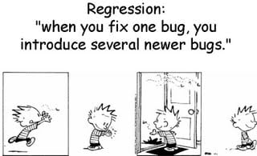
Context(Introduction)
Regression testing is important because
Detects costly code
Prevents degradation of the software
Preserves code that is already working
Notes:
Users may have poor experience because software is not working properly.
Software cost may rise more than it should.
Reputational repercussions.

Slide 4
Problem
How can someone effectively detect performance regression with the least cost of resources?
Commit
Regression?
dismiss
Code is fine
hit
Add to list
Test/fix code
Notes:
Might need to explain the whole process here. Conduct code → Predict the potential regression issue → get a list → schedule the test → confirm the result.
Running constant benchmark tests can be too costly, but waiting too long to run a benchmark test can make finding the error much more difficult.
This is why predicting when a change at the commit level will cause a regression problem is so important.

Slide 5
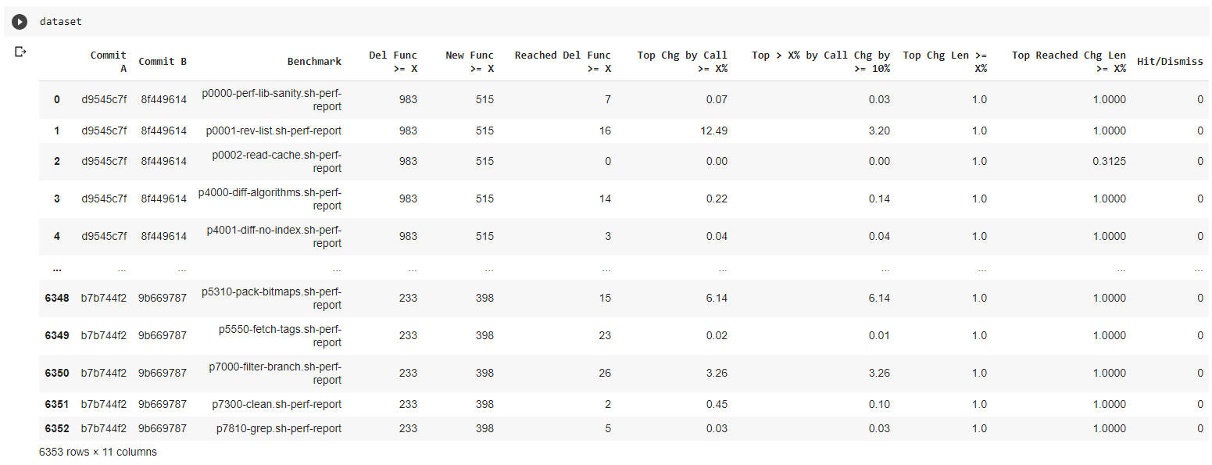

Original Dataset
Talk a bit our first dataset

Slide 6
Research question
RQ1: Which algorithm to use for the classification of hit/dismiss for our given dataset?
Answer:
The team carried out a comparative analysis between multiple Machine Learning classification algorithms, namely:
K-Nearest Neighbors classifier
Random Forest Classifier
Naive Bayes Classifier

Slide 7
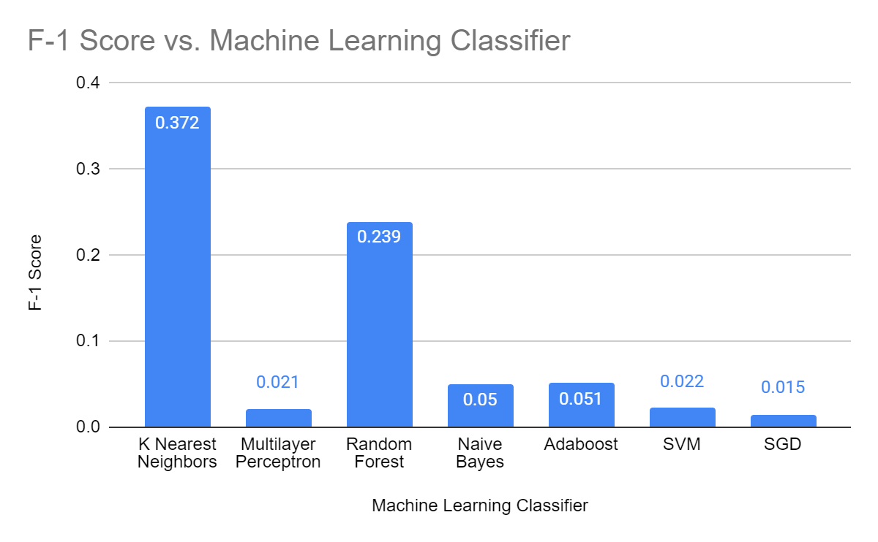
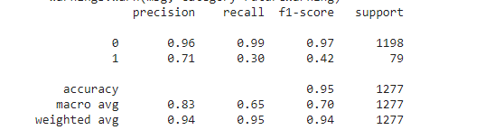
Results and Issues
Notes:
What is our important metric and why?

Slide 8
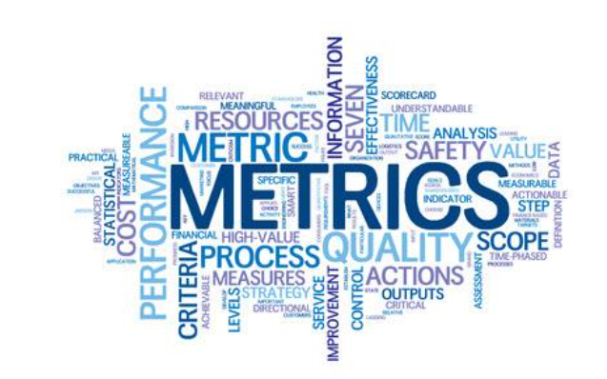
New dataset
The problems encountered in the original dataset were aimed to be resolved by curating and extending the dataset.
For doing this, several software quality metrics were employed.
Source: Prof. Mohamed Wiem Mkaouer

Slide 9
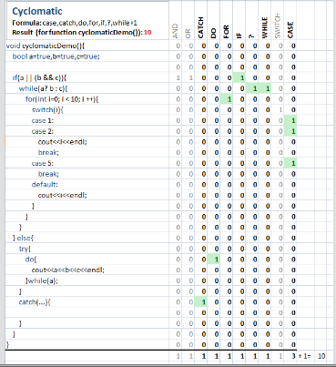
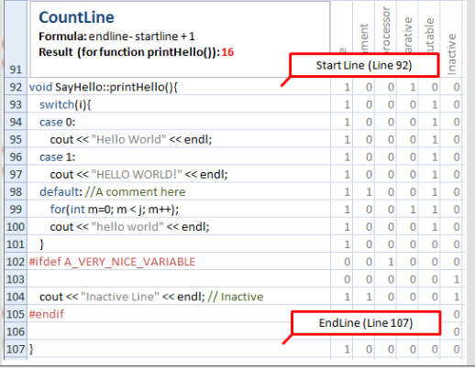
Features
Tools like Understand allow for extraction of metrics like:
Cyclomatic Complexity (Strict and Modified)
Max
Sum
Average
Count of lines
Blank
Code
Comment
Exe
Declarative
Inactive code
Notes:
Complexity -> Number of decision points in a one-entry, one-exit program + 1

Slide 10
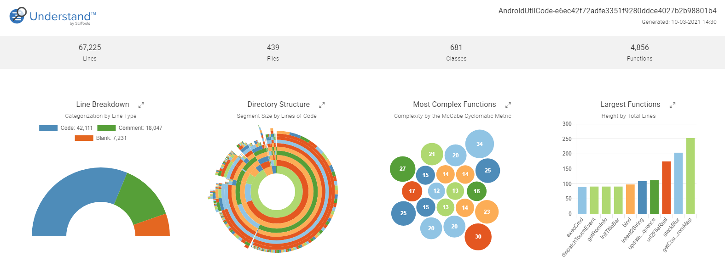
Why software quality metrics ?
McCall defined Quality Criteria as an attribute of a quality factor that is related to software development.
It is because of this that the before mentioned quality metrics like Complexity and Lines Of Code provide insights into the relationship of a given commit to whether it might cause performance regression or not.

Slide 11
Comparison of old Dataset and New Dataset
Factor Dataset | DataSet v1.0 | DataSet v2.0
No of columns | 11 | 50
No of features | 7 | 46
Best Results (F1 score for 1) | 0.37 | 0.75
Best Results (Recall for 1) | 0.41 | 0.64

Slide 12
Research question
RQ2: How can we improve the accuracy of our model?
Answer:
Future work will require trials of hyperparameter tuning. For better optimization of the model’s performance, the team applied two methods of feature selection.

Slide 13
The detail of solving the problem using new dataset
The dataset includes a total of 46 features which needs a bit of work before feeding into the model.
Feature selection processes were employed which include the following:
Manual Selection (Pearson’s Correlation Coefficient)
Visualize Feature importances using Shapash

Slide 14
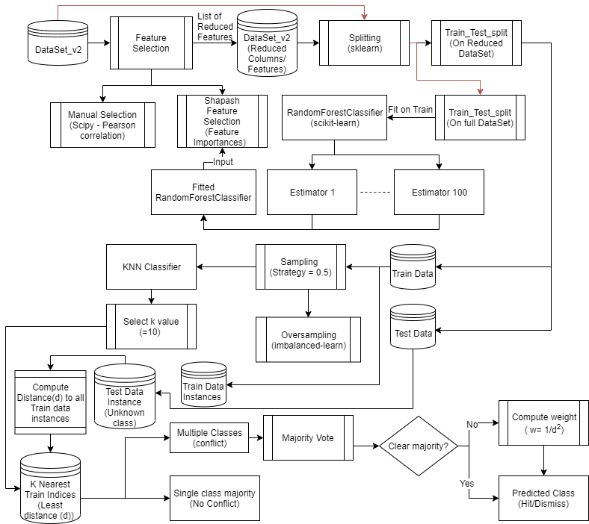
Approach

Slide 15
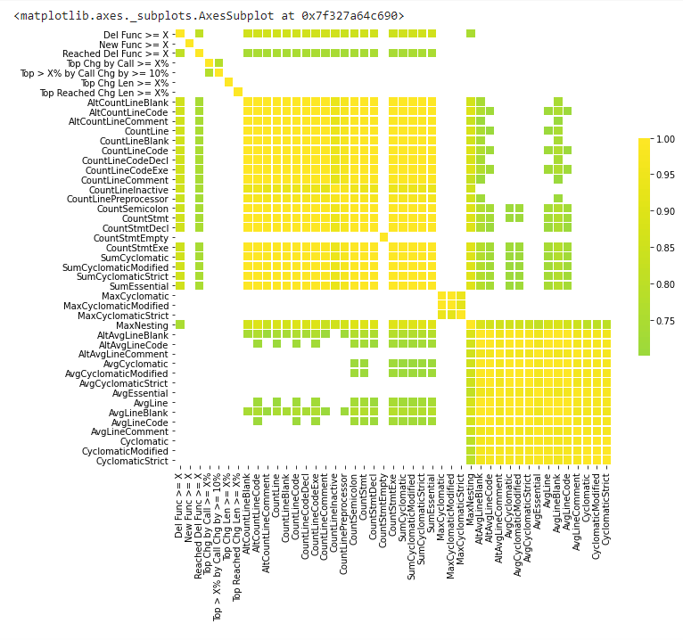
Manual Feature Selection (Pearson’s Correlation Coefficient)
These features were manually selected:
'Del Func >= X',
'New Func >= X',
'Reached Del Func >= X',
'Top Chg by Call >= X%',
'Top > X% by Call Chg by >= 10%',
'Top Chg Len >= X%',
'Top Reached Chg Len >= X%',
'MaxCyclomatic',
'AvgLine'

Slide 16
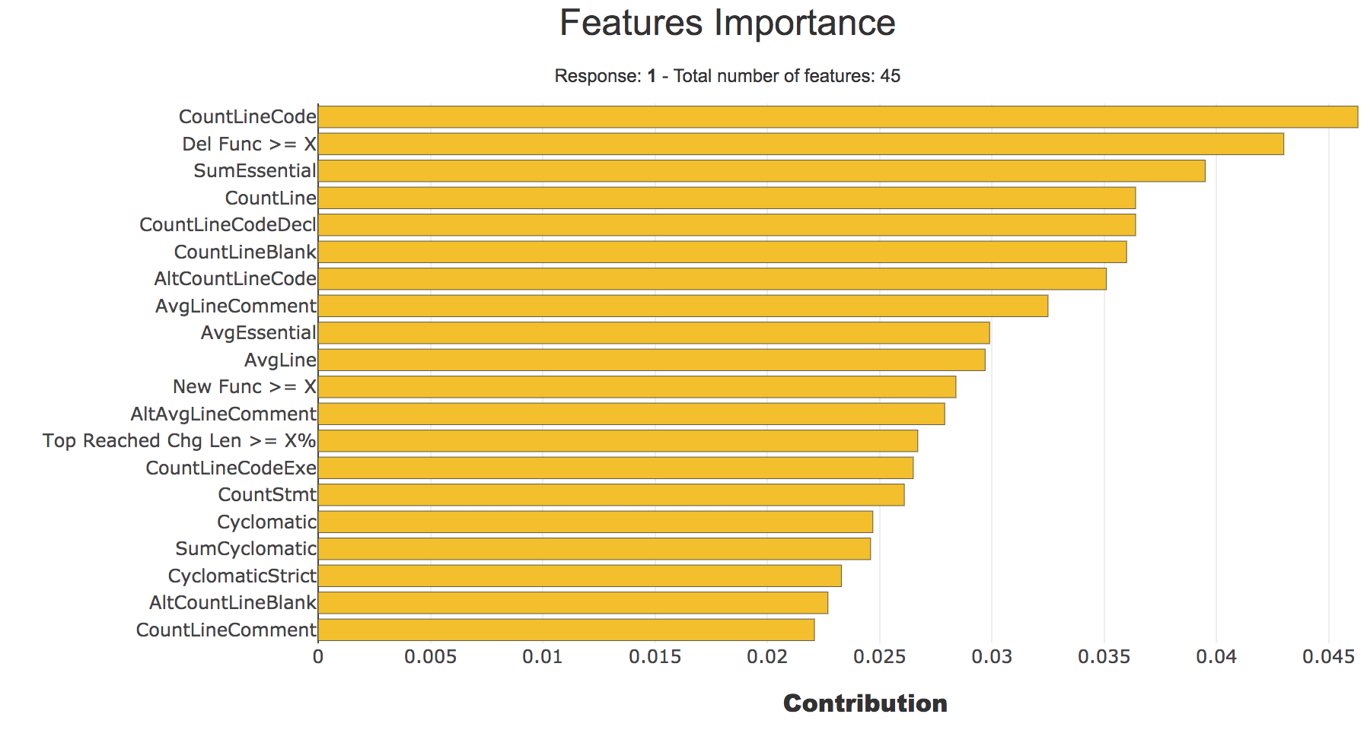
Visualizing Feature Importances using Shapash
Random Forest Classifier is fit and fed into Shapash
These features are the most important ones in the total 45 features. We selected a total of 13 features which have contribution values above 0.025.

Slide 17
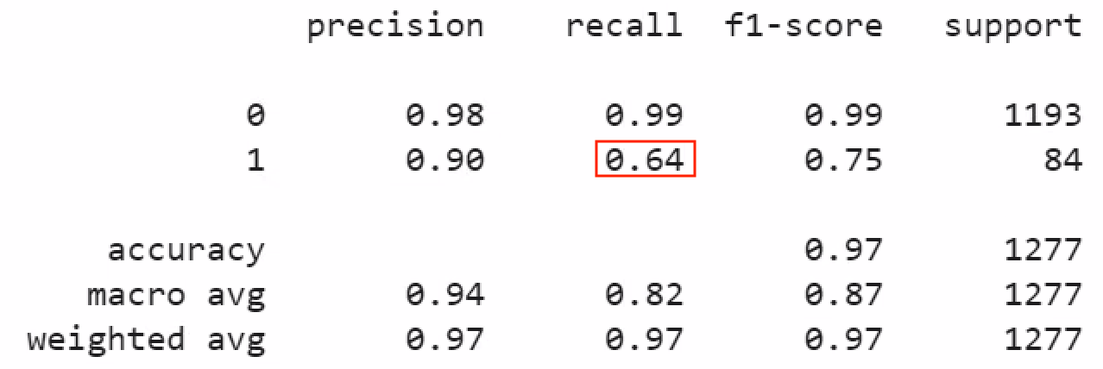
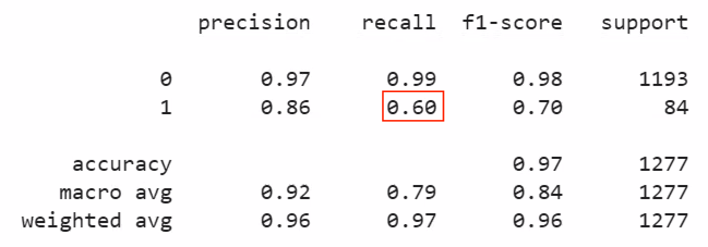
Result
KNN
RFC
Notes:
hyperparameter

Slide 18
Threats
conclusion validity Imbalance data (6% hits) | construct validity Software, Hardware environment
internal validity Model ( KNN, RF, SGD, …) Feature selection( 46 features - pearson’s correlation, feature importance) | external validity Structure of every project
Notes:
External - These can be seen in the dimension of the dataset. Data collected from one project may vary entirely from data collected within another project. This could potentially create an artificial environment where the model is fine tuned to work on these specific types of commits, but fail on other projects commits. Thes solution to this problem will likely be a topic in future works.
Construct - Construct threats to validity can be seen in the evaluation of the models.The f-1 score is often the focus, but as models are fine-tuned it will become important to focus on the precision and recall scores. For this task specifically, the recall score is important as it determines the amount of false negatives that are presented from the model. The data is composed of real world commits.

Slide 19
Conclusion & Future work
Future work: TCP, evolutionary algorithm(like: nsga-ii)
Feature selection
Oversampling in training set
KNN, RFC

